Slide 1
NCHS
Mental Health Analysis
Shuran Yang

Slide 2
Table of contents
01
04
02
05
03
06
Introduction
Visualizations
Why this project
Graphs and charts via Pandas, Matplotlib, and Seaborn
Data
Dashboard Showcase
Exploratory analysis and cleaning
Interactive Tableau dashboard
Missing Values
Analysis & conclusion
Models and interpolation
Conclusion from above graphs and interpretation

Slide 3
1
Introduction

Slide 4

Find me on:
LinkedIn
Github
I am an undergrad junior studying Data Science at University of California Berkeley.
Now I am working on this project as a data science consultant!

Slide 5
Introduction to NCHS & mental health data
NCHS (National Center for Health Statistics) partnered with the Census Bureau on an experimental data system called the Household Pulse Survey. The mental health data is gained from this survey for the purpose to learn more about citizen’s mental health status, whether or not they have received enough support, and potential reasons of these issues.
I, as a data scientist, found myself particularly interested in this dataset because of my personal experience in fighting against mental health problems (anxiety and depression). And this dataset is broad in scale (covers different level of demographic data), and also have enough observations to reduce bias.

Slide 6
2
Data

Slide 7
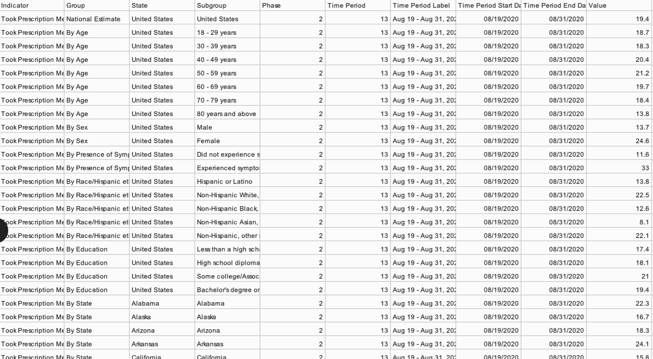
Dataset

Slide 8
Columns
Group | Observation_Count
National Estimate | 152
By Age | 1064
By Sex | 304
By Presence of Symptoms of Anxiety/Depression | 304
By Race/Hispanic ethnicity | 760
By Education | 608
By State | 6732
By Disability status | 168
By Gender identity | 156
By Sexual orientation | 156

Slide 9
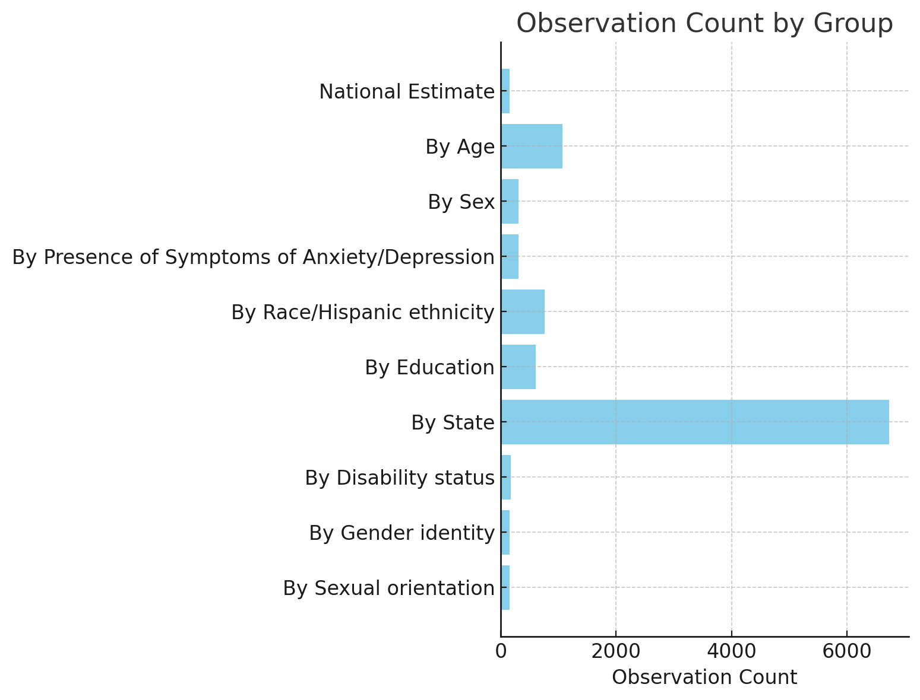
Columns and Factor Variables
From this graph we can more clearly see how many variables may be considered as factors that impact the value - percent of participants that have mental health issues. And among them State and Age has the most observations.
This decide the potential model we want to use and how we may draw graphs in the future steps.

Slide 10
Column Variables and Interpretation
Indicator
Time Period Start Date
Means whether or not the participant has received professional support
Took Prescription Medication for Mental Health, Last 4 Weeks
Received Counseling or Therapy, Last 4 Weeks
Needed Counseling or Therapy But Did Not Get It, Last 4 Weeks
Took Prescription Medication for Mental Health And/Or Received Counseling or Therapy, Last 4 Weeks
The survey is sent out every 4 weeks while the survey questions are asked with a 12-month reference period
Value
Value means percent of participants that have certain answer or are under certain group/subgroup (i.e. female that took prescription medication for mental health in the last 4 weeks.)

Slide 11
3 - 4
Missing Values &
Visualizations

Slide 12
Null Values
Group | Null_Count
By Age | 153
National Estimate | 20
By Sex | 40
By Presence of Symptoms of Anxiety/Depression | 40
By Race/Hispanic ethnicity | 100
By Education | 80
By State | 9
By Disability status | 24
By Gender identity | 12
By Sexual orientation | 12

Slide 13
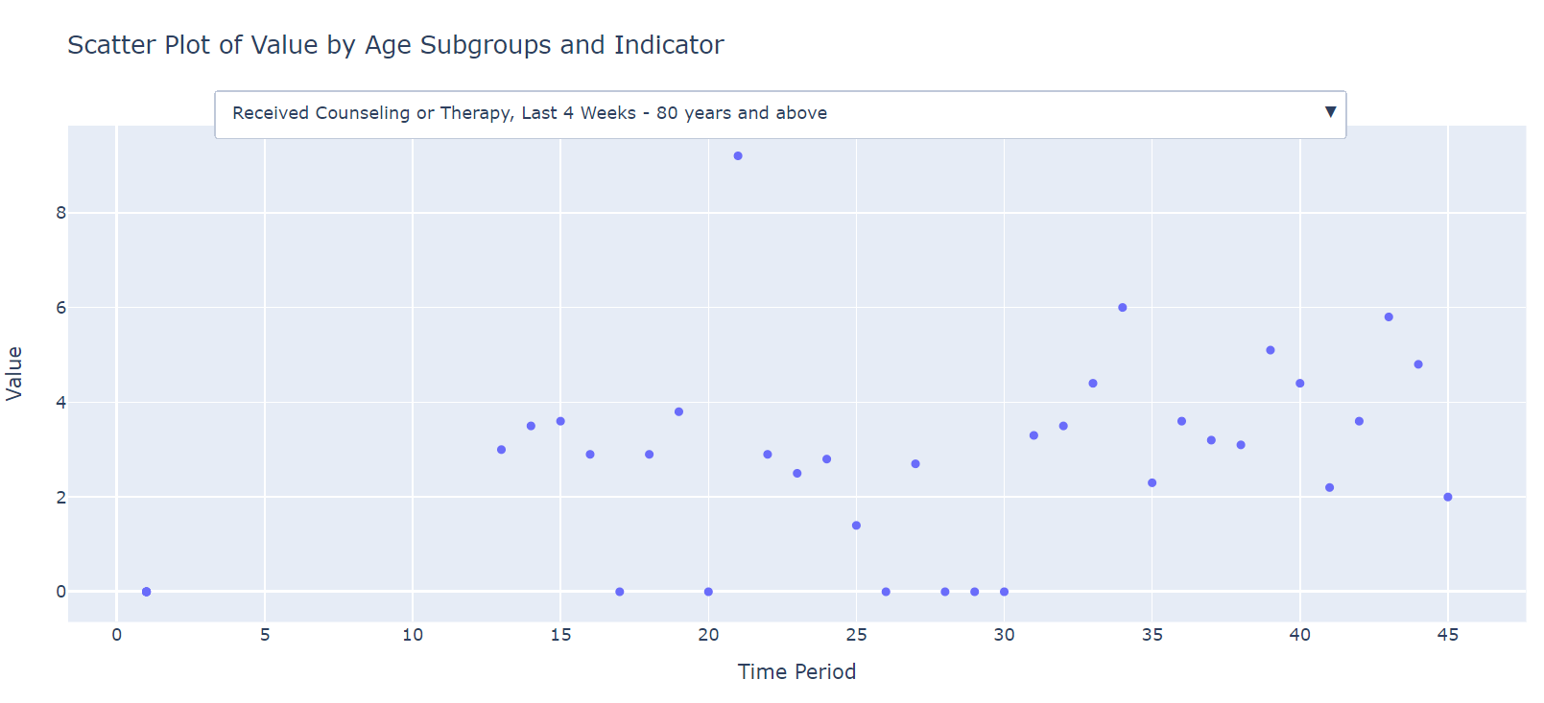
Missing Value and Interpolation
Missing values replaced by 0s

Slide 14
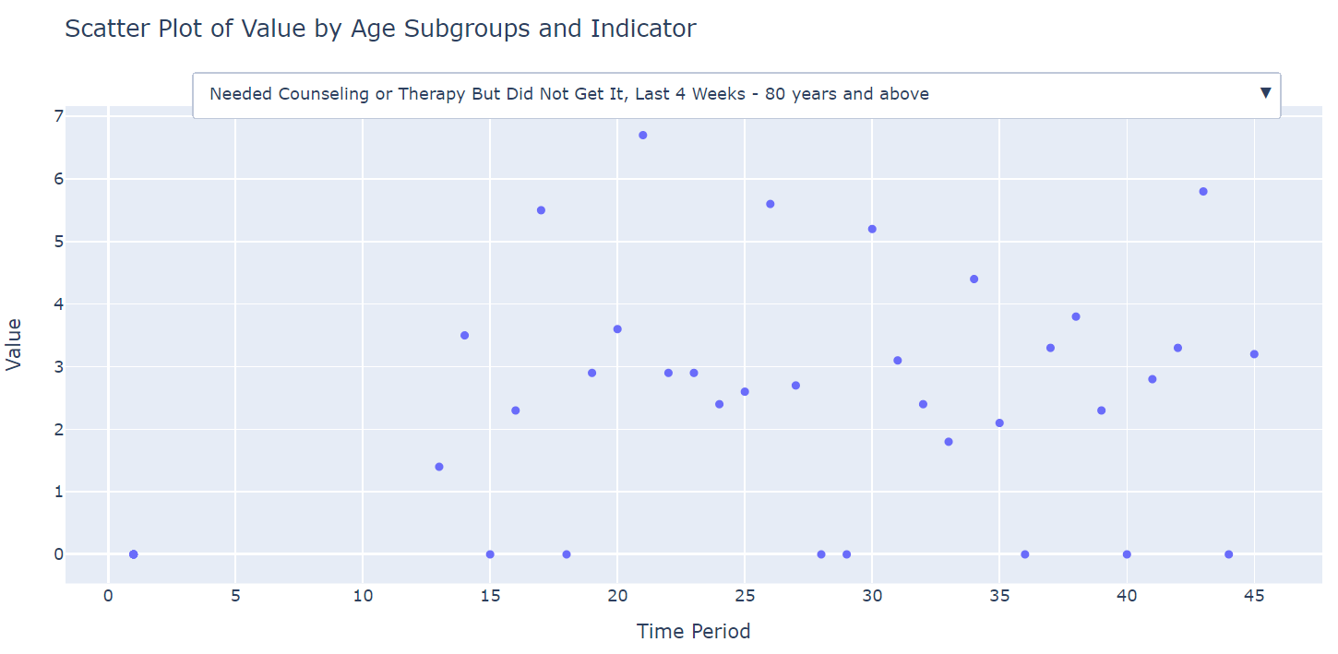
Missing Value and Interpolation
Missing values replaced by 0s

Slide 15
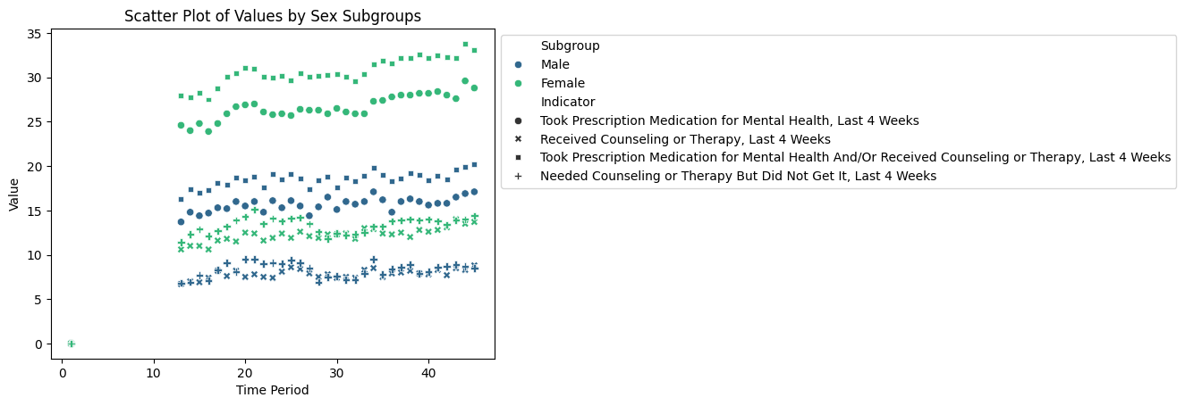
Missing Value and Interpolation
The plot by sex subgroup has shown independent linear pattern for each indicator category

Slide 16
Missing Value and Interpolation
When we replace null values with 0s, we can see that they are outliers that may prevent us from gaining an useful or accurate pattern.
Thus I decided to divide the data by group and sub group, like shown in the graph below, in order to find possible pattern that the null values can fit in.
Eventually I found that the data is in a relatively linear regression line, which lead to the next step of interpolation.

Slide 17
Missing Value and Interpolation
First we use one-hot-encoding to transfer categorical data to numerical values
Then we use LinearRegression() function to develop a model to fit in all the data
We chose Indicator, Group, Subgroup as X variables, and Value as Y variable
Because this batch of dataset is relatively small, we will try to use cross-validation here to find a more accurate performance metric
neg_mean_absolute_error: -2.027 (std: 0.031)
neg_mean_squared_error: -6.80 (std: 0.29)
r2: 0.90 (std: 0.004)

Slide 18
Linear Regression and Performance
V=β0 + β1 × I + β2 × G + β3 ×S + ε
R2
Std of neg_MSE
neg_MAE
The model explains about 90.04% of the variance in the target variable.
The std value suggests that the model's MSE is also quite consistent across different folds.
This means the model's predictions are, on average, 2.03 units away from the actual values.

Slide 19
5
Dashboard
Click the Tableau Link to interact

Slide 20
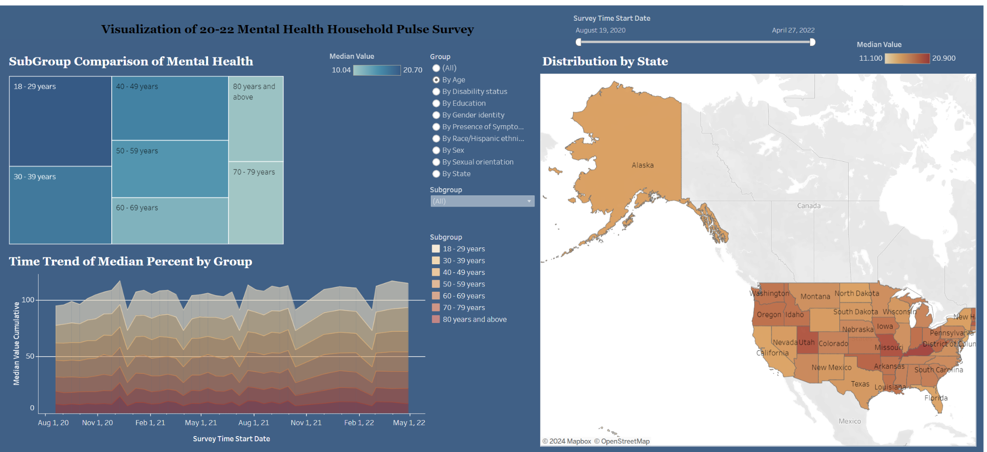

Slide 21
6
Analysis

Slide 22
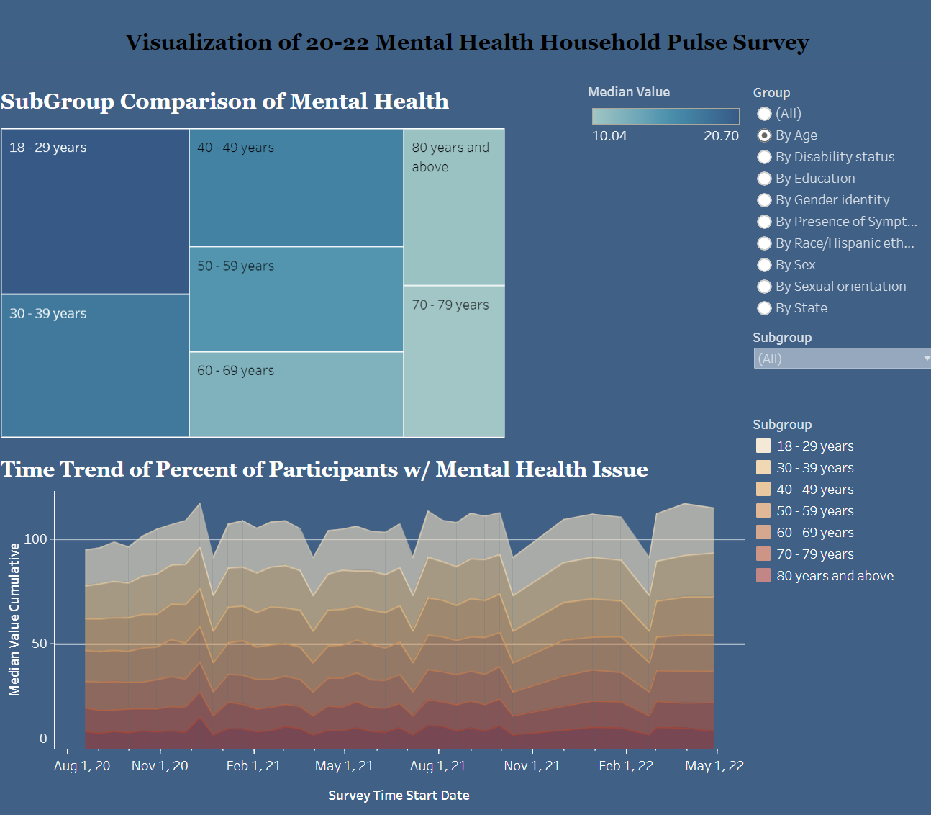
Analysis and Conclusion
The visualizations clearly demonstrate that mental health concerns have risen from 2020 to 2021. It's evident that the age groups of 18-29 and 40-49 show relatively higher rates of mental health issues. Interestingly, the 50-59 age group seems to be receiving more consistent mental health support, particularly through prescription medication.

Slide 23
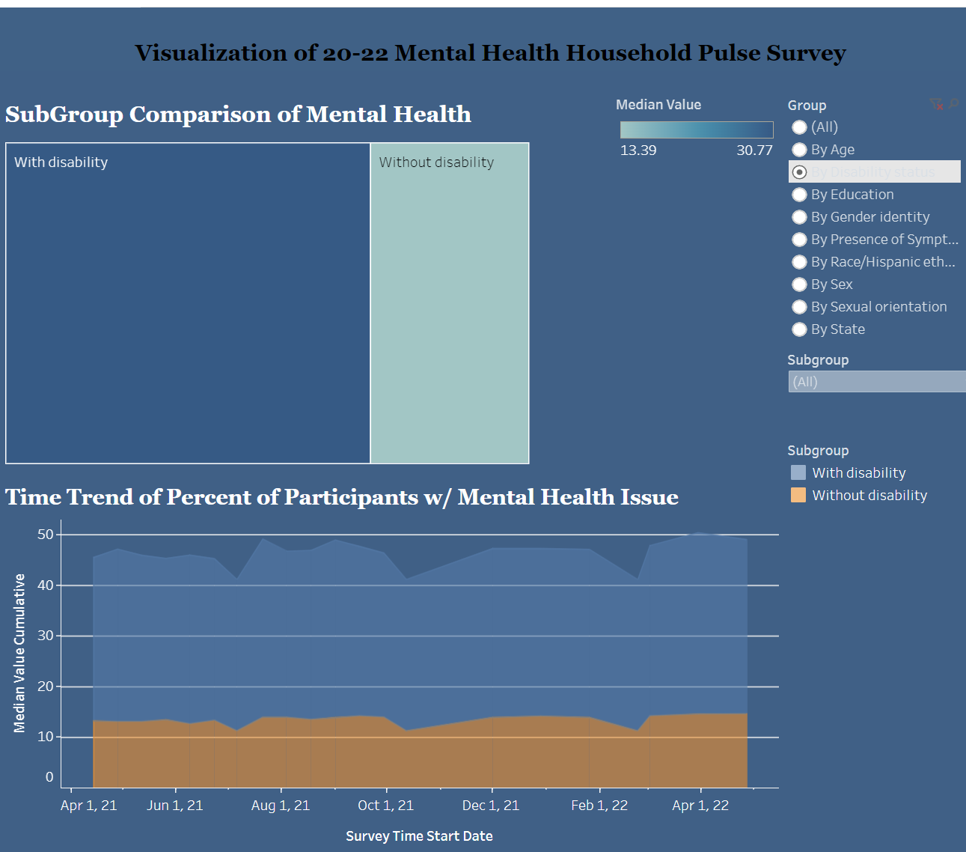
Analysis and Conclusion
Those with disabilities are shown to have a higher prevalence of mental health issues, which suggests an intersectional approach is needed in mental health services.

Slide 24
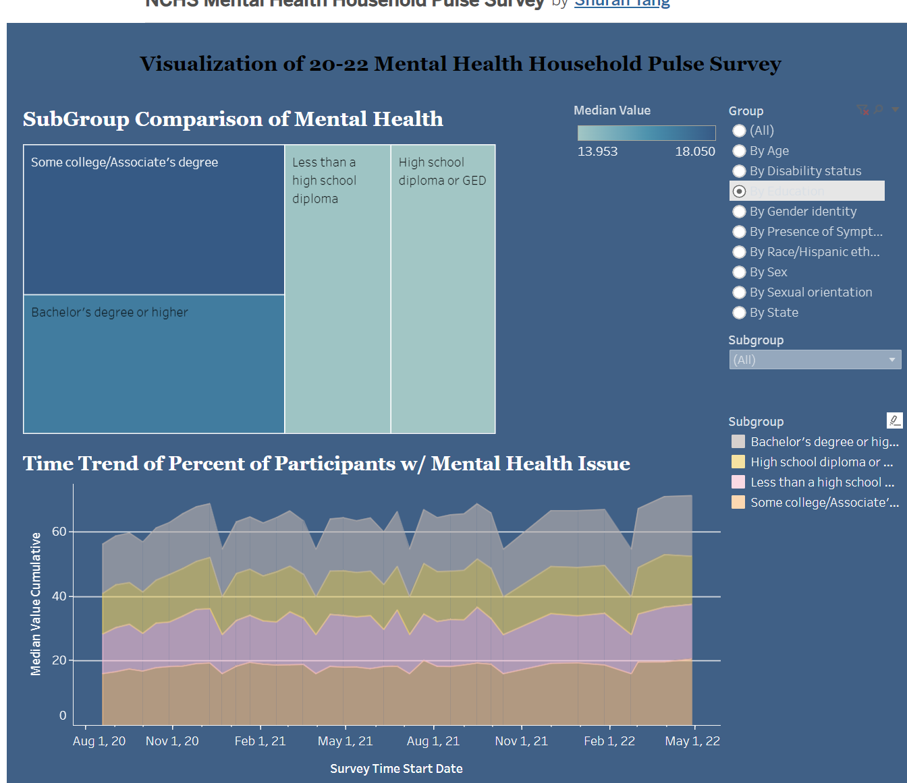
Analysis and Conclusion
The data also reflects that individuals with higher educational attainment are more likely to seek help for mental health concerns.

Slide 25
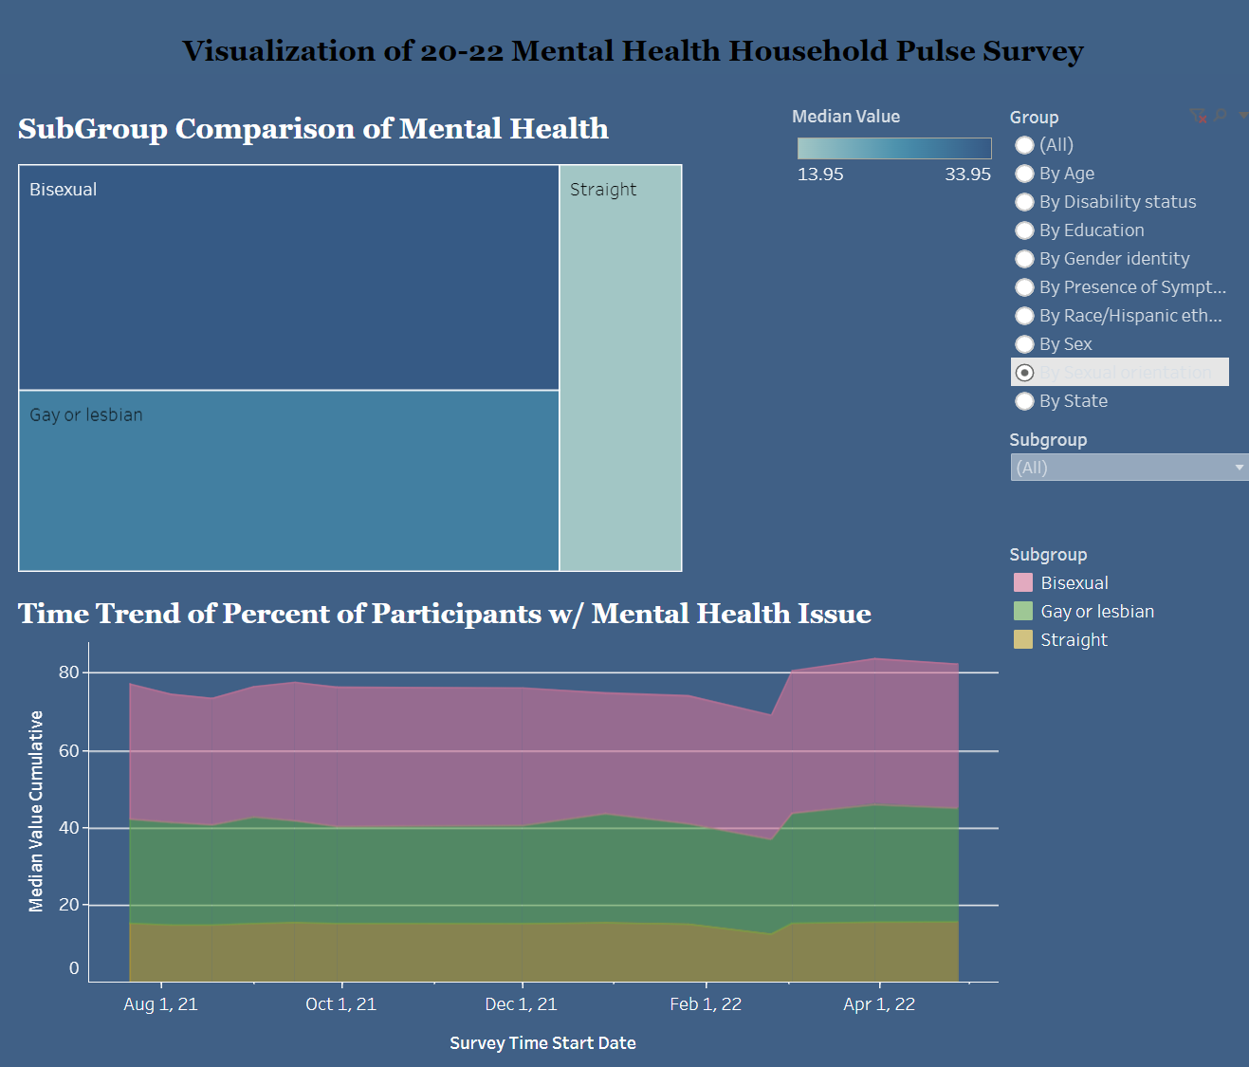
Analysis and Conclusion
Sexual orientation appears to play a role, with minority groups facing more challenges in mental health, potentially indicating underlying social stresses such as discrimination. The transgender community, in particular, shows a significantly higher median rate of mental health concerns compared to cisgender individuals, highlighting a crucial need for inclusive support.

Slide 26
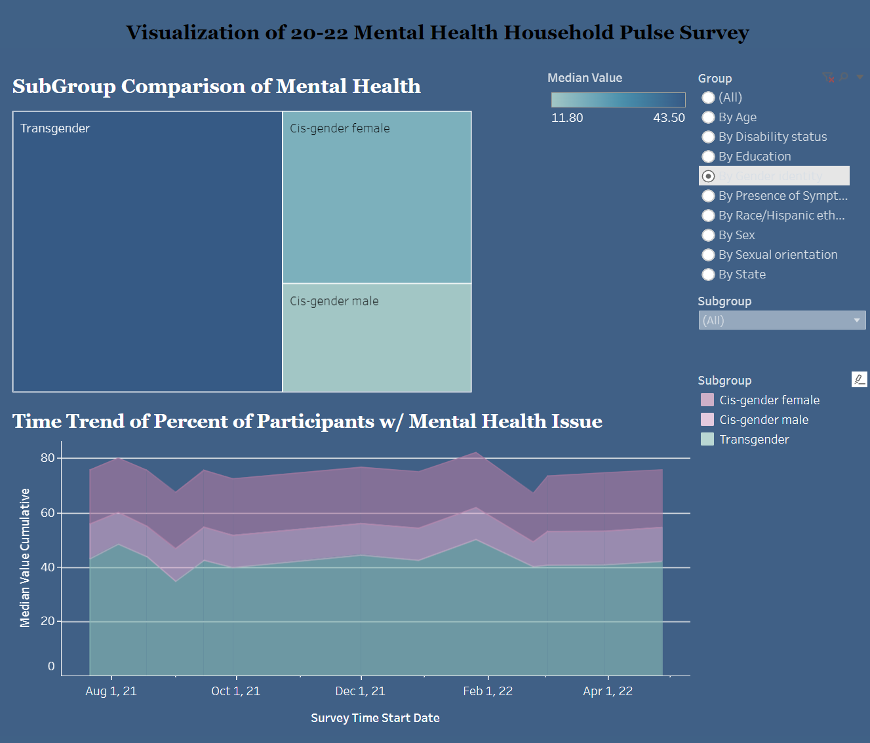
Analysis and Conclusion
Sexual orientation appears to play a role, with minority groups facing more challenges in mental health, potentially indicating underlying social stresses such as discrimination. The transgender community, in particular, shows a significantly higher median rate of mental health concerns compared to cisgender individuals, highlighting a crucial need for inclusive support.

Slide 27
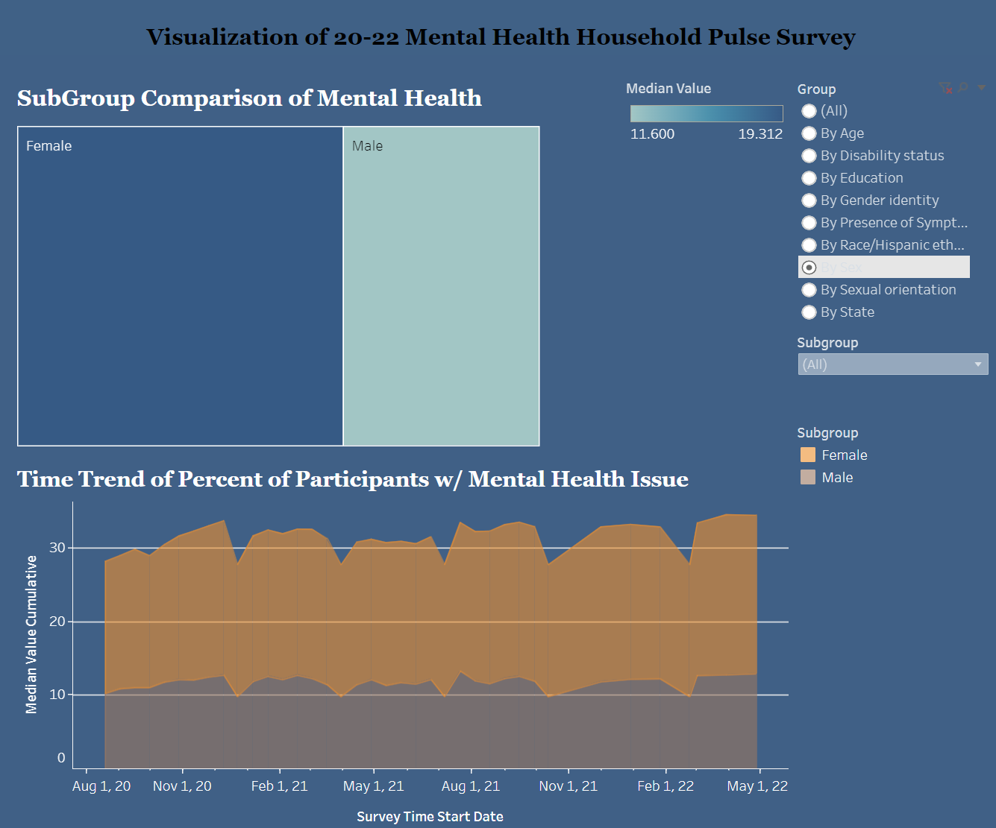
Analysis and Conclusion
Female group also has higher percentage of population that experienced mental health problems especially during the COVID period, either due to gender inequalities in accessibilities of professional support, or due to the biological difference or different personal experience from male group.

Slide 28
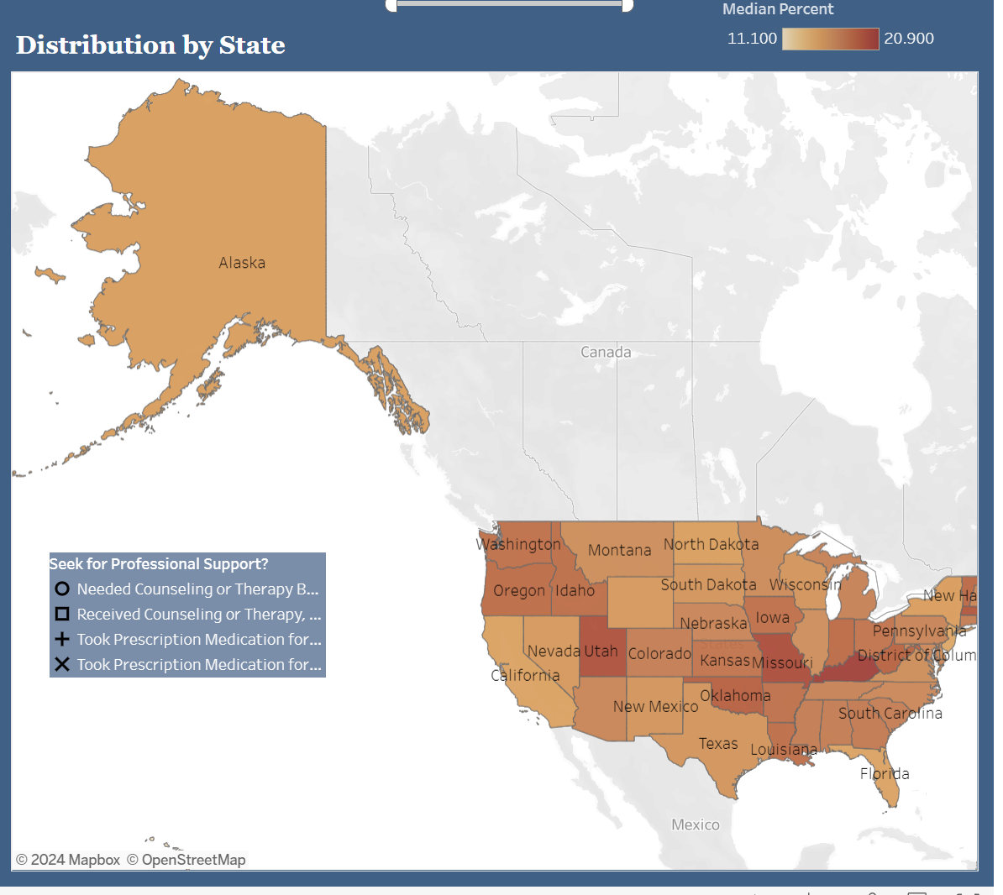
Analysis and Conclusion
Geographically, the states of Oregon, Utah, Colorado, and Washington show a higher percentage of people who have unmet needs for mental health support. This finding suggests potential areas where healthcare accessibility and services could be improved.

Slide 29
57,800,000
Number of people have mental illness in U.S.
NAMI

Slide 30
The Future
To address these findings, strategies may include:
Developing targeted mental health programs for high-risk age groups.
Expanding telehealth services to improve access in states identified with unmet needs.
Implementing educational campaigns to reduce stigma and promote mental health literacy across all educational levels.
Strengthening support for minority groups, with specific attention to culturally competent care that addresses the unique challenges faced by these populations.
Advocating for policy changes to ensure healthcare systems are inclusive and equipped to serve diverse gender identities effectively.
Increasing research into the social determinants of mental health to inform more equitable healthcare policies.

Slide 31
Bias
People are biased. Data is biased, in part because people are biased. Algorithms trained on biased data are biased. - Yann LeCun
Selection Bias: The data may not represent all demographic groups equally, particularly those with limited access to technology or healthcare.
Reporting Bias: Individuals might underreport their mental health issues due to stigma or misreport due to misunderstanding questions.
Non-response Bias: The survey's response rate could affect the data's representativeness if certain groups are less likely to participate.
Recall Bias: Participants may not accurately remember or report their mental health care over the past four weeks.
Sampling Bias: If the sample is not adequately randomized or stratified, it might not reflect the broader population accurately.

Slide 32
Thank you!
LinkedIn
Github

Slide 33

Resources
Dataset
Mental Health Care in the Last 4 Weeks NCHS
Google Sheet Dataset
Scripts and Graphs
Colab Notebook
Tableau Dashboard
Reference
NAMI Report

